Slide 1
Cypress Data-Attributes & Basic Methods (get,find & within) Presented by: Khurram Muslim

Slide 2
Data Attributes
Use data-* attributes to provide context to your selectors and isolate them from CSS or JS changes.
Don't target elements that may change their textContent
Don't target elements based on CSS attributes such as: id, class, tag
Add data-* attributes to make it easier to target elements

Slide 3
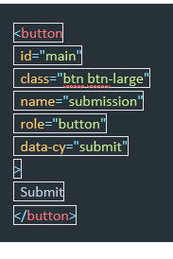
How It Works:

Slide 4
Comparing the way of targeting elements
Selector | Recommended | Notes
cy.get('button').click() | Never | Worst - too generic, no context.
cy.get('.btn.btn-large').click() | Never | Bad. Coupled to styling. Highly subject to change.
cy.get('#main').click() | Sparingly | Better. But still coupled to styling or JS event listeners.
cy.get('[name=submission]').click() | Sparingly | Coupled to the name attribute which has HTML semantics.
cy.contains('Submit').click() | Depends | Much better. But still coupled to text content that may change.
cy.get('[data-cy=submit]').click() | Always | Best. Isolated from all changes.

Slide 5
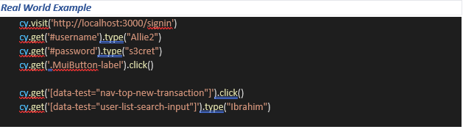
Selector Playground automatically follows these best practices.
When determining an unique selector it will automatically prefer elements with:
data-cy
data-test
data-testid

Slide 6
get() method
Syntax: cy.get(selector) or cy.get(selector, options)
Examples:
If you want to get an input type element: cy.get('input’)
Specify logging as false. Moreover, it will skip the command output printing on the Cypress Test runners console: cy.get('input',{ log: false })
Requirements: cy.get() requires being chained off a command that yields DOM element(s).

Slide 7
find() method
Syntax: .find(selector) or .find(selector, options)
Examples:
<ul id="parent">
<li class="first"></li>
<li class="second"></li>
</ul>
// yields [<li class="first"></li>, <li class="second"></li>]
cy.get('#parent').find('li’)
.find("a[href*=footer]")
Requirements: .find() requires being chained off a command that yields DOM element(s).

Slide 8
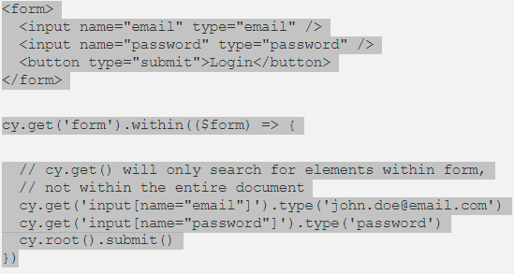
within() method
Syntax: .within(callbackFn) or .within(options, callbackFn)
Examples:
Requirements: .within() requires being chained off a previous command.

Slide 9
THE END

